Slide 1
Big Data Analytics for Public Policy
Lecture 1

Slide 2
Overview
Housekeeping
Motivation
Goals of class
Specific Approach
Introduction to data
Examples of previous analyses

Slide 3
Overview
Housekeeping
Motivation
Goals of class
Specific Approach
Introduction to data
Examples of previous analyses
Groups

Slide 4
Housekeeping
Please come to class on time
Lectures will be recorded
Please be prepared and submit assignments on time
No electronic devices during lectures
Please ask questions
Please read syllabus

Slide 5
Grading I
Individual assignments (50% of the grade)
Mostly python exercises that use analytical methods we discussed in the lecture
If you have troubles, spend some time googling (Stackoverflow), then ask your class-mates, then us
We can't help you if you reach out the night before submission deadline, so start as soon as possible
Assignments up to 24 hours late will have their grade reduced by 50%; assignments up to two days late will have their grade reduced by 75%; three days late not accepted.

Slide 6
Grading II
Research projects with two short presentations (10% each) and research memo (10%)
Presentations are held in class. Each of you will provide short updates on your analytical project
The research memo at the end should be 5 pages describing the analytical project you worked on and discuss the results

Slide 7
Grading III
Code and Metadata documentation (10%)
Documentation is important for reproducibility. We will ask you to submit all your code at the end of class.
Active participation (10%)
Participate in discussions (in class or on the NYU class forum), share your opinion, ask
Questions, help classmates in case they struggle (share code snippets and help debug code)
Share information you come across that might be interesting for your classmates as well
Make use of office hours to discuss your progress in class

Slide 8
Questions, Help, Support
Stackoverflow and Google
NYU Class Forum
This is enabled for you so you can post any problems you encounter during your class work.
You can help your classmates and reply with solutions or suggestions
Reach out to us
Come and see us in office hours
Submit your questions for virtual office hours via this form

Slide 9
Office Hours
Julia: available upon request by email
Dani:
In Office: Fri 2pm-4pm at NYU Wagner, you can come by any time
Virtual: Mon and Wed 4pm-6pm, email your questions through NYU classes

Slide 10
Overview
Housekeeping
Motivation
Goals of class
Specific approach
Introduction to data
Examples of previous analyses
Group projects

Slide 11
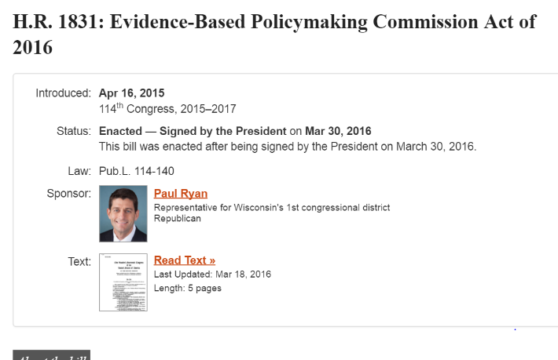
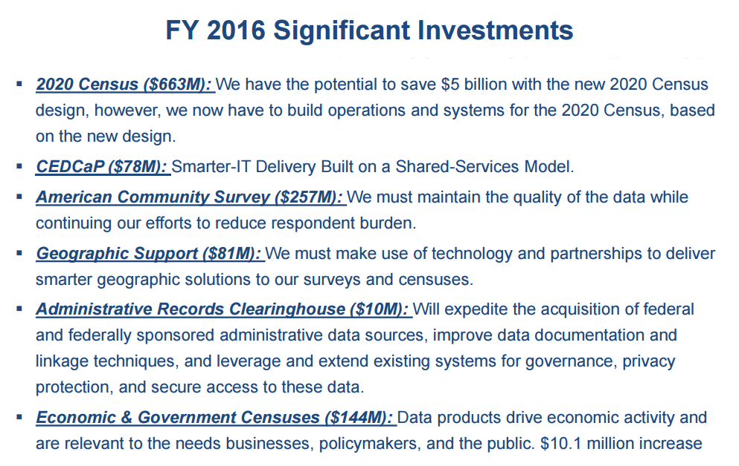
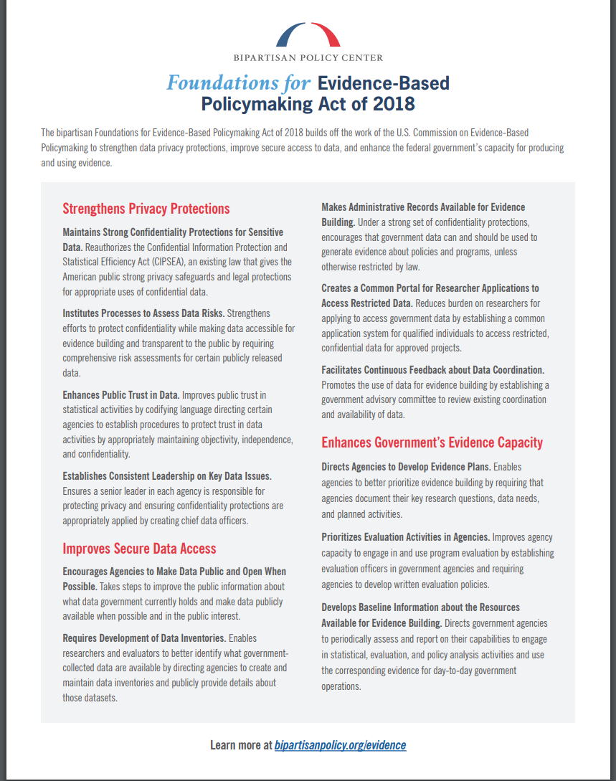

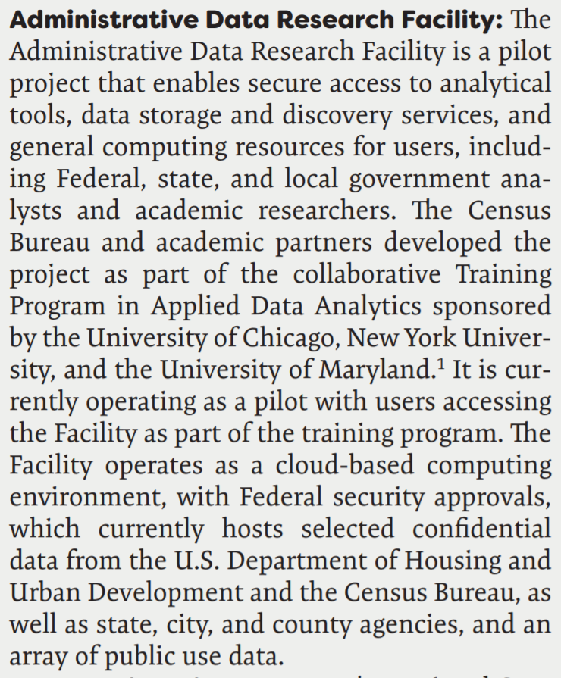
Federal Policy Context

Slide 12
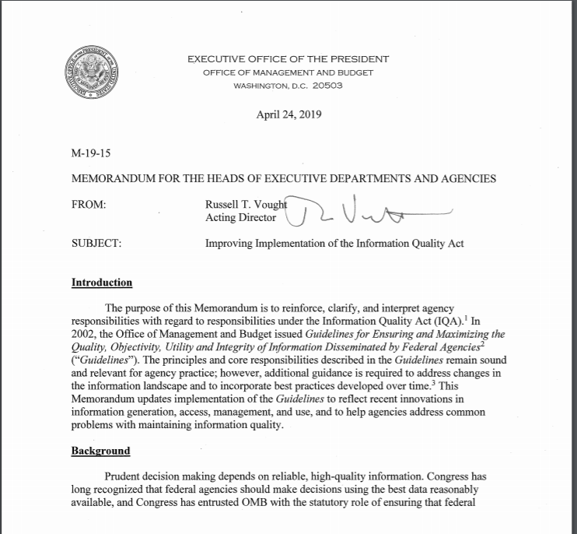
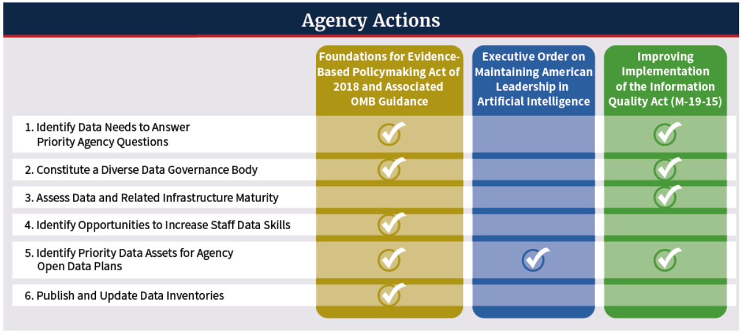
More Context

Slide 13

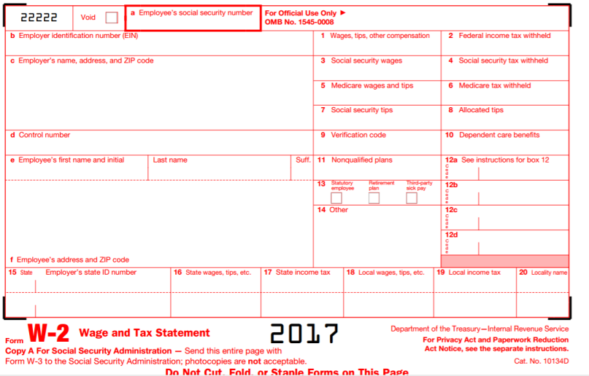
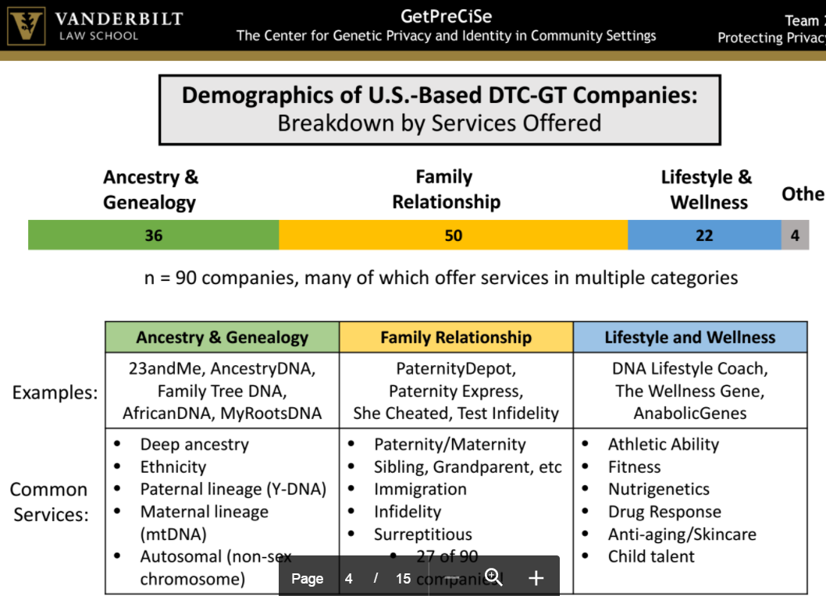
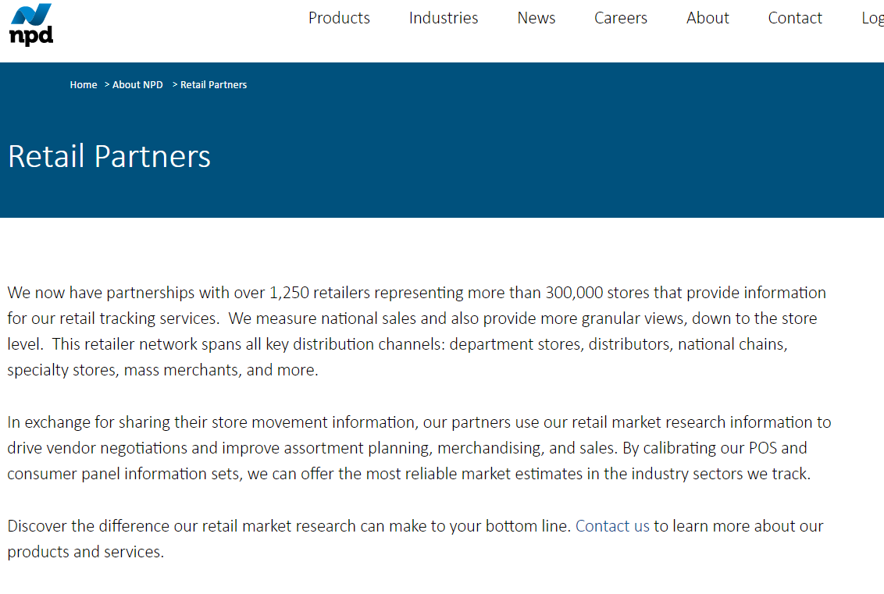
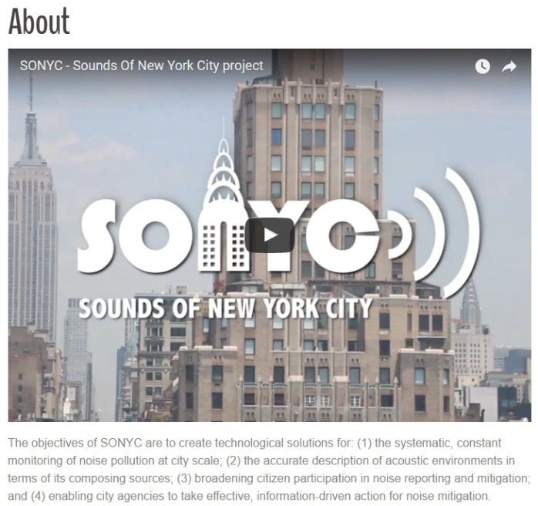
Data in social sciences
Surveys
Administrative records
Transaction data

Slide 14


What does this mean for you?

Slide 15
Necessary skills
Code and collect new data
Manage complex data,
Apply machine learning, text and network analysis
Visualize relationships
Address inference issues
Manage privacy and confidentiality

Slide 16
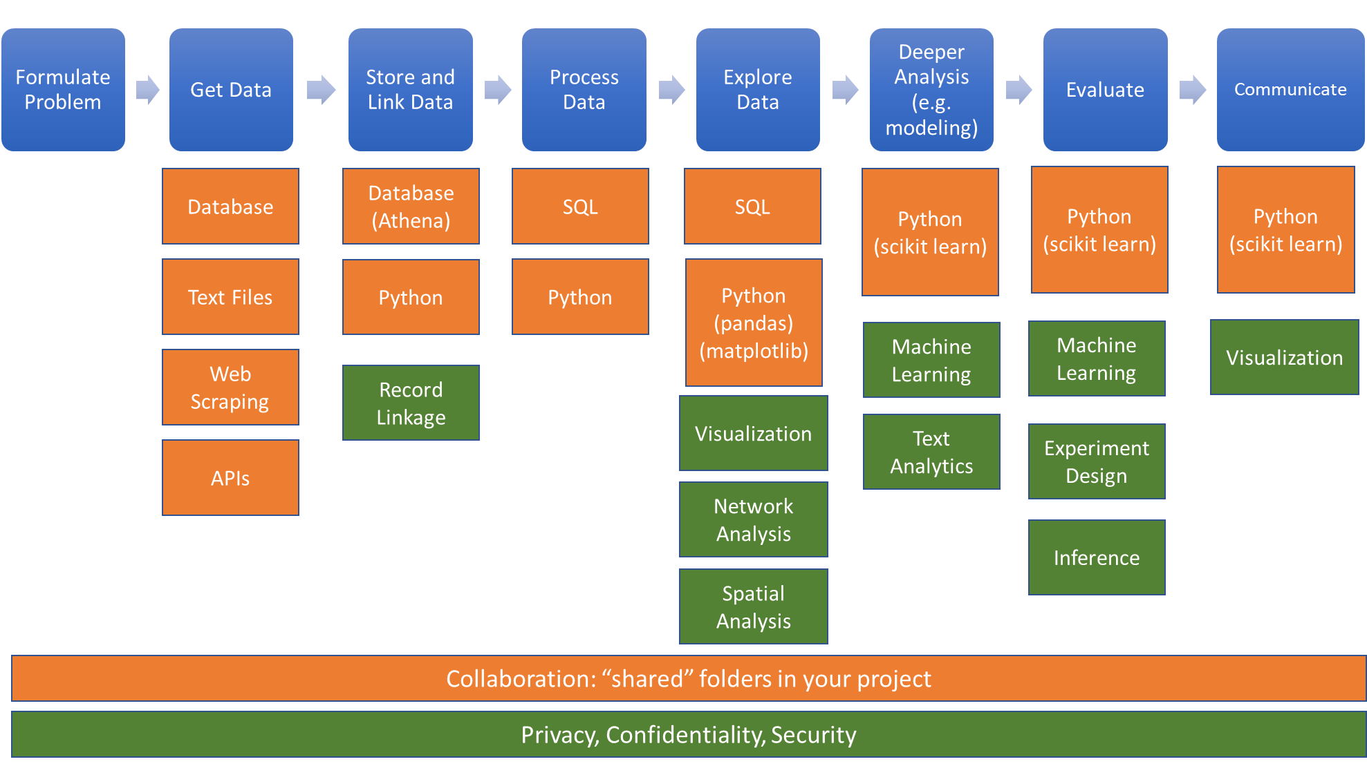
Skills and Tools

Slide 17

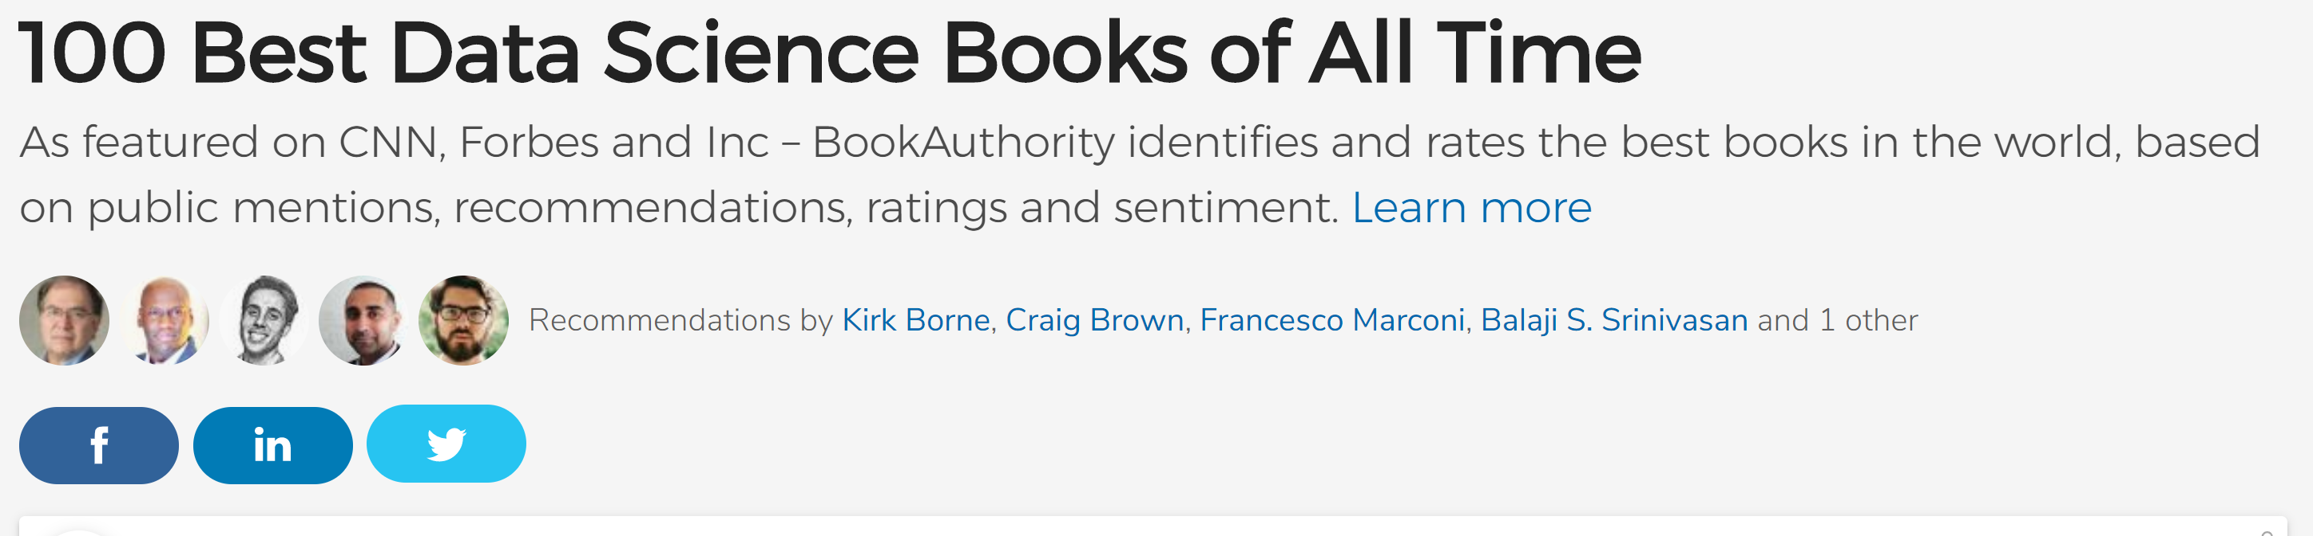

Slide 18
Build around social science question – why innovation?
“while Science and innovation are central pillars of the President’s agenda, … innovation measurement in the United States ‘remains rudimentary”
Will provide overarching theme and structure for the class
Data already being built => leverage existing investments
Burgeoning community of interest

Slide 19
Overview
Housekeeping
Motivation
Goals of class
Specific Approach
Introduction to data
Examples of previous analyses

Slide 20
Broader goals
Think about new paradigm
Questions
Coverage
Data structure
Linkage/unique identifiers/disambiguation
Learn about new approaches
Computer science and social science
Private sector and government sector

Slide 21


Value for Policy - example
Health
NZ Super
Social security and welfare
Education
Other
Core Governmentservices
Finance costs
Transport and communication
Law and order
Defence
Budget 2018
Budget 2018
Source: Sir Bill English, former NZ PM
Frankadvice.co.nz

Slide 22


Administrative data
Aged
1 | 2 | 3 | 4 | 5 | 6 | 7 | 8 | 9 | 10 | 11 | 12 | 13 | 14 | 15 | 16 | 17 | 18 | 19
CYFS
Abuse Findings
Care
Education
Youth Justice
Income support
Total cumulative paid ($1000)
 |  | 6 |  |  |  | 18 |  |  | 37 |  |  | 53 | 58 | 71 | 120 | 126 | 127 | 142
Source: Sir Bill English, former NZ PM

Slide 23
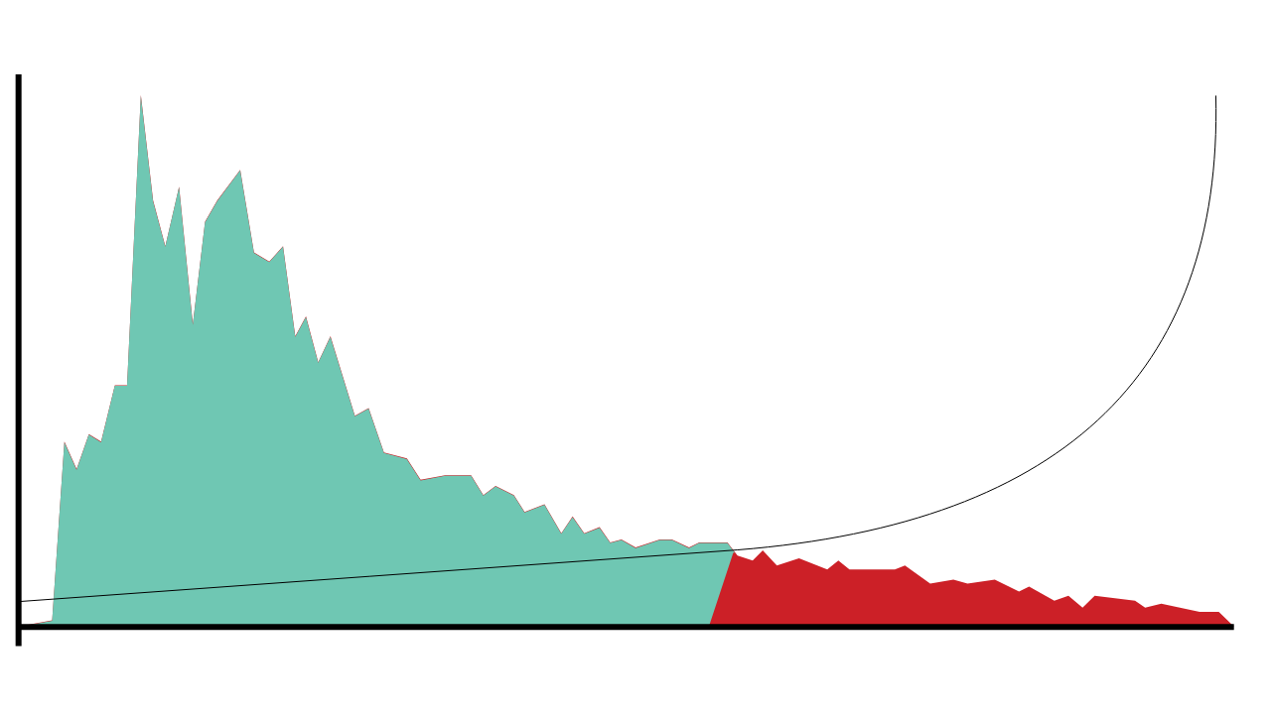

Understanding risk
The risk profile of this cohort reveals a long tail of increased risk.
2,500
The hypothetical cost effectiveness of interventions increases when they are delivered to the students who need them most.
48,077 low-risk students have an average risk of 27%
Number of students
1,250
6,990 high risk students have an average risk of 76%
0
0%
Risk of not achieving NCEA2 by age 18
100%
Source: Sir Bill English, former NZ PM
The Investment Approach: Australia and New Zealand

Slide 24
Aggregate liability valuation
Total liability
72.2 billion
$13.7 billion​
Increase due to policy package to reduce child poverty – because of the method we employ, this can be isolated
Liability decrease related to experience, $billions
Liability reduction
attributable to system reform
Updated model assumptions
Client numbers
Source: Sir Bill English, former NZ PM

Slide 25

Cohort liability estimates
Of that $72.2 billion, 75% is attributable to clients who entered the benefit system under the age of 20.
High-liability cohorts include:
Sole parents
People who churn in and out of the benefit system
Ex-prisoners on release
Young people with disabilities or chronic conditions, who want to work but need support to do so.
Source: Sir Bill English, former NZ PM

Slide 26
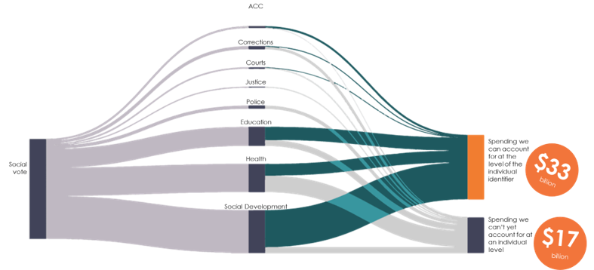
Understanding return on investment
We're able to link two thirds of service costs to individuals
Source: Sir Bill English, former NZ PM

Slide 27
And how do we deal with privacy?
“As part of Child Fatality Review, department heads in Baltimore City government get together once a month. We review every child death that happened in the city since the previous meeting. We ask what more we might have done to prevent that tragedy. In many cases, each of us has a file on the child or the family at least an inch thick. It’s tragic to compare notes after the child has died—what more could we have done when the child was alive?.”
DR. LEANA WEN, COMMISSIONER OF HEALTH, CITY OF BALTIMORE

Slide 28
Overview
Housekeeping
Motivation
Goals of class
Specific Approach
Introduction to data
Examples of previous analyses
Group projects

Slide 29
Specific Approach
New analytical approach
Start with basic question
What are the characteristics of the population of the United States?
Characterize the economic activity of US businesses
…What is the link between federal R&D and innovation?

Slide 30

Value of Science
1951: NSF established
The NSF “found a void in the basic data essential to sound planning. The first step toward policy formulation is necessarily the painstaking task of accumulating relevant data concerning the national effort in scientific research and development”
Fifth Annual Report of the National Science Foundation, 1955 (Washington, DC: US Government Printing Office, 1955) – cited by Al Teich, 2017

Slide 31
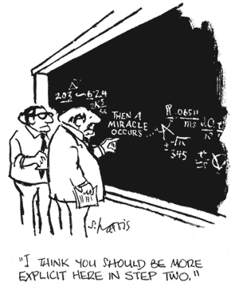

Value of Science
How much should a nation spend on science? What kind of science? How much from private versus public sectors? Does demand for funding by potential science performers imply a shortage of funding or a surfeit of performers?......A new “science of science policy” is emerging, and it may offer more compelling guidance for policy decisions and for more credible advocacy

Slide 32

Value of Science

Slide 33
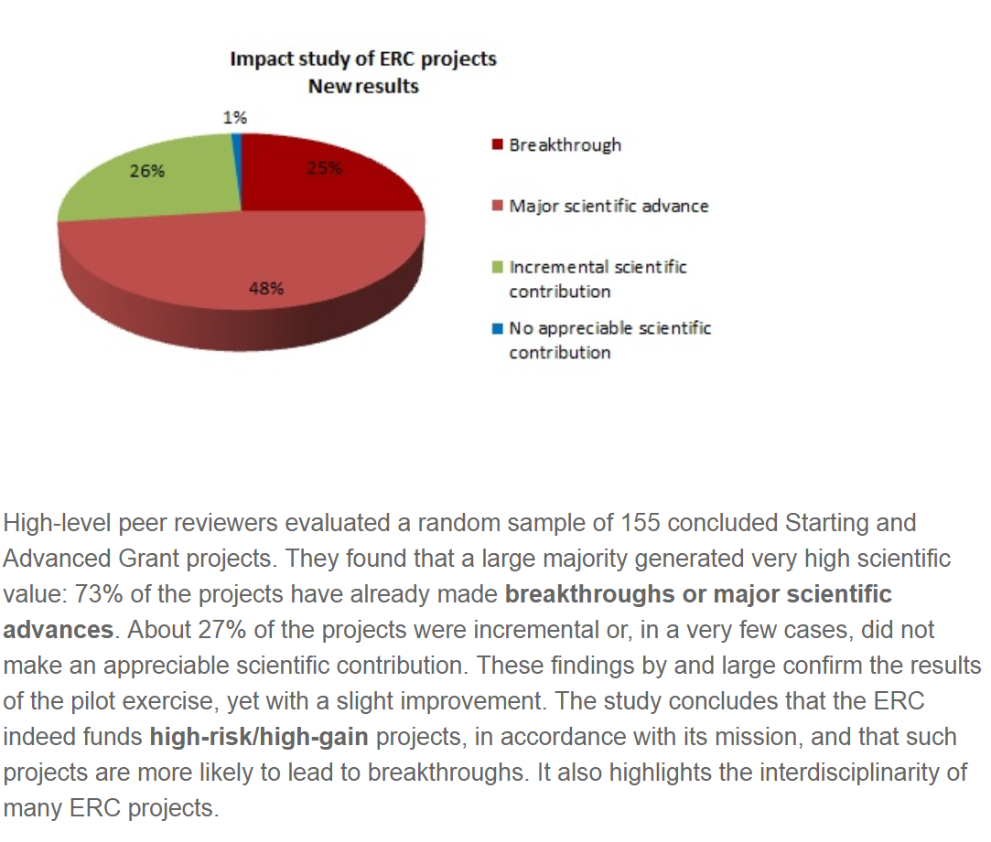

What not to do: self-evaluate

Slide 34

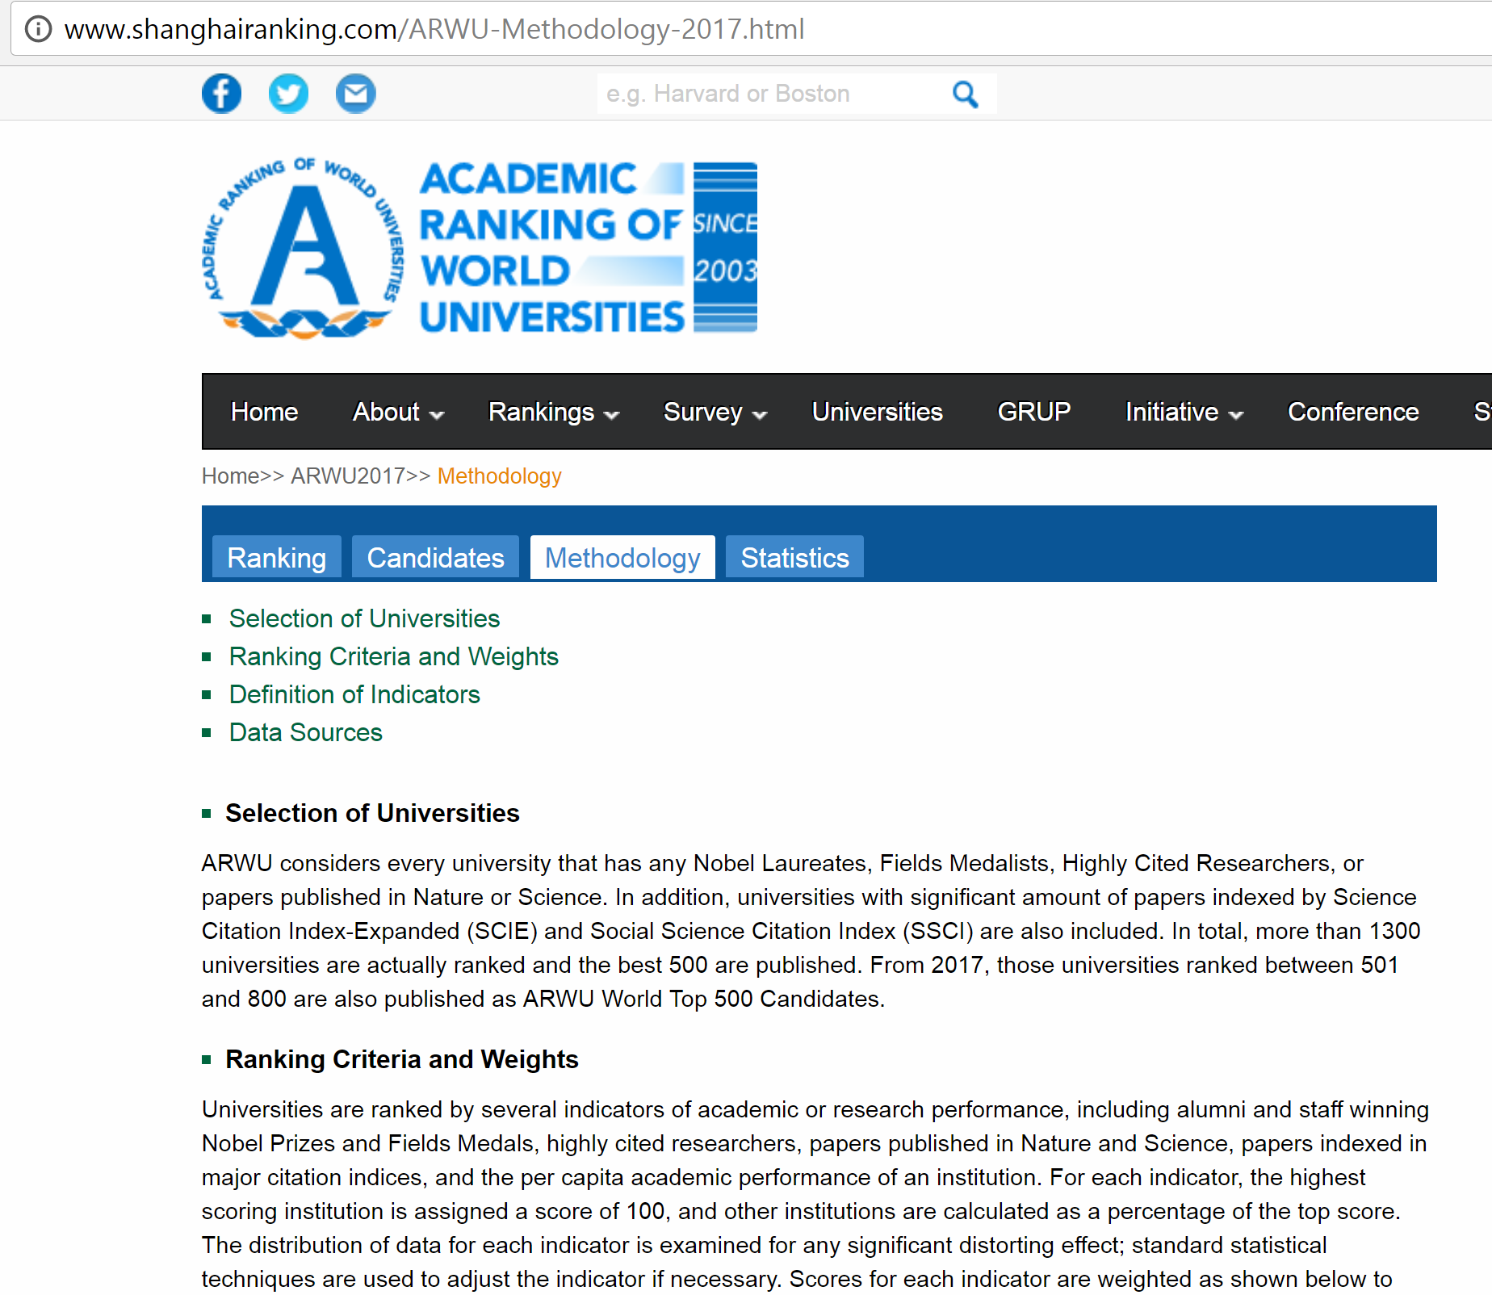
What not to do: Ad-hoc approaches

Slide 35

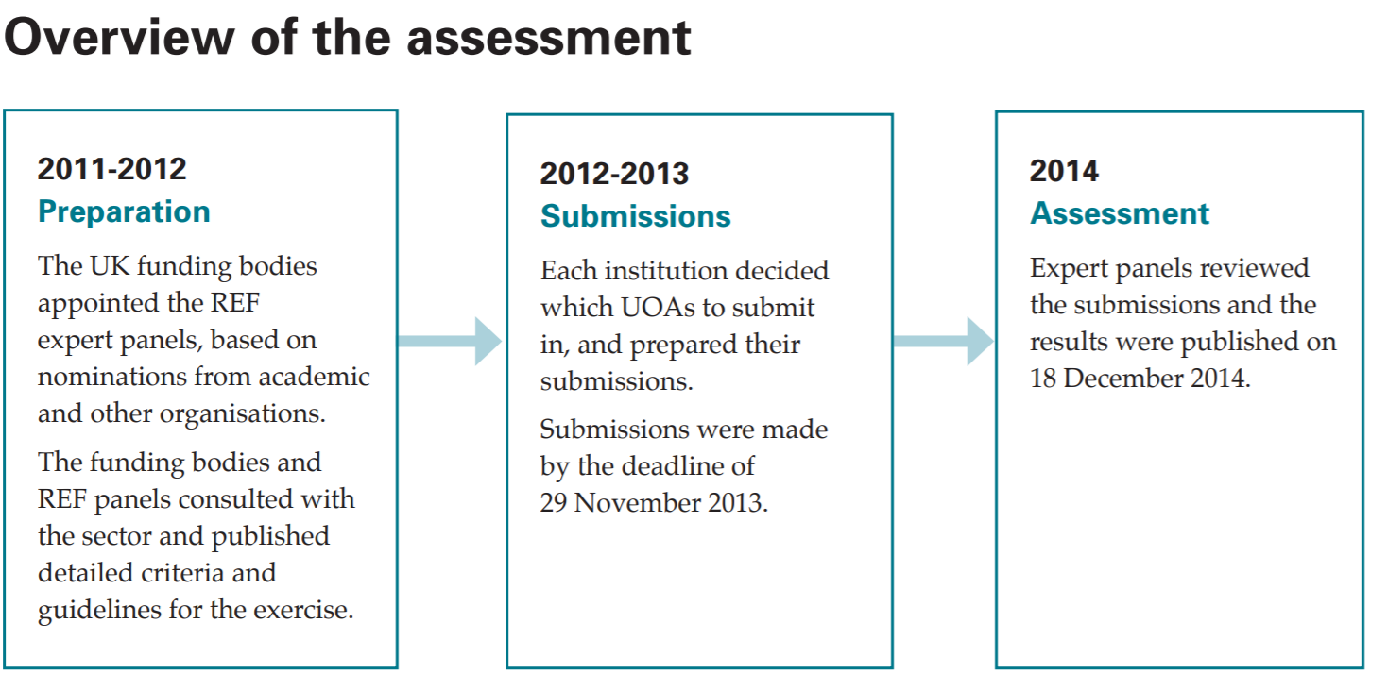
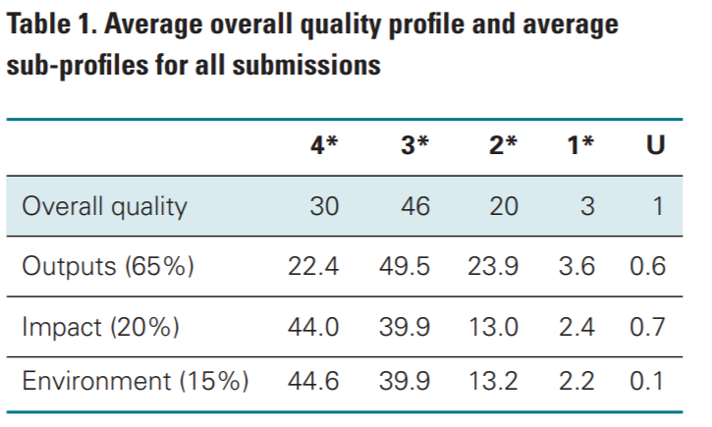
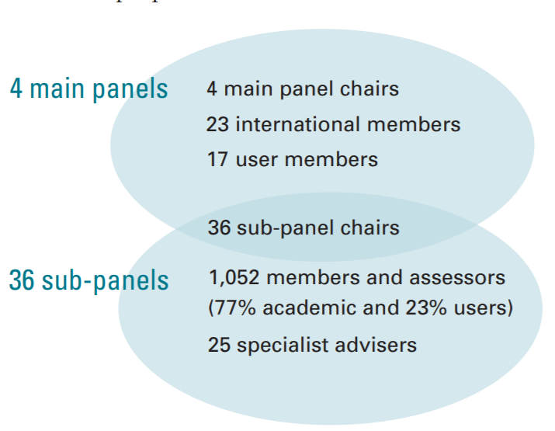
What not to do: Bureaucratic madness

Slide 36
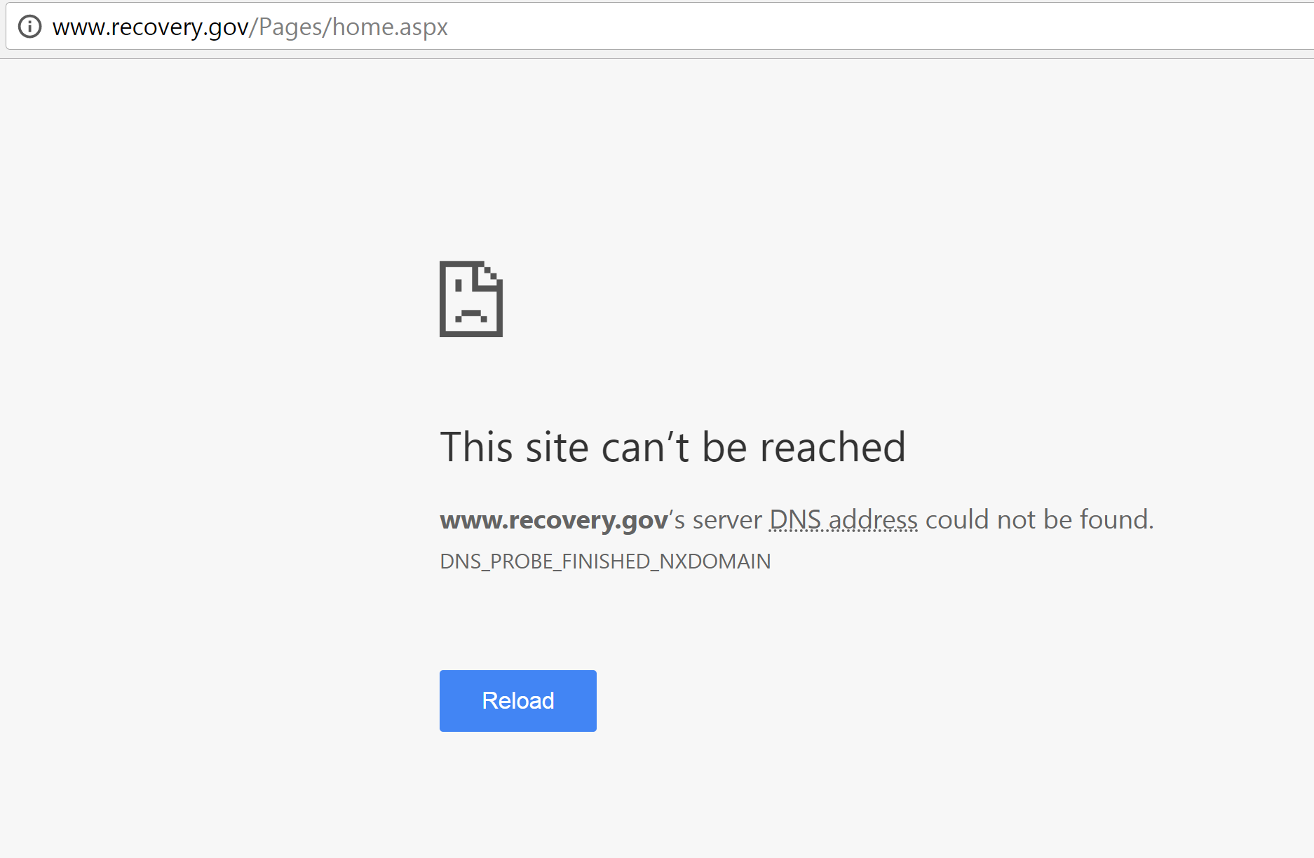
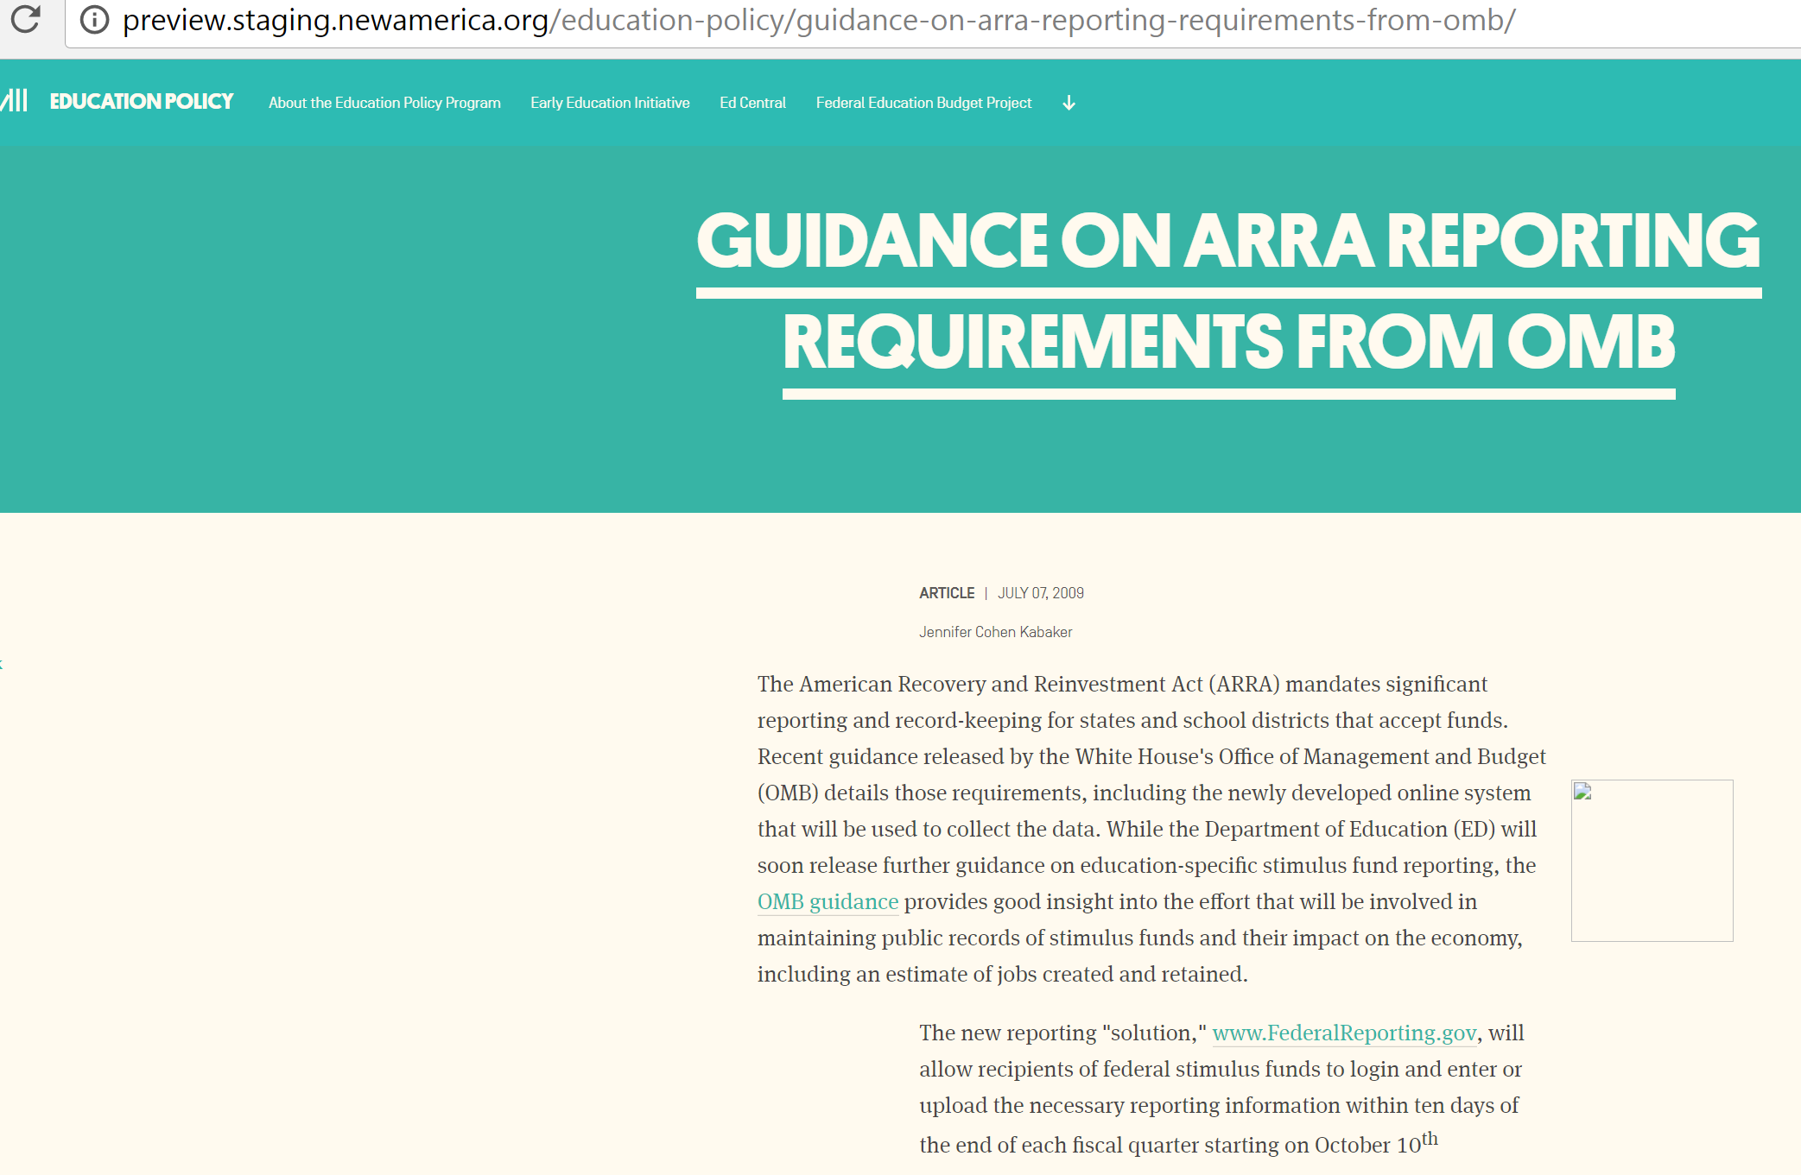
What not to do: manual reporting

Slide 37
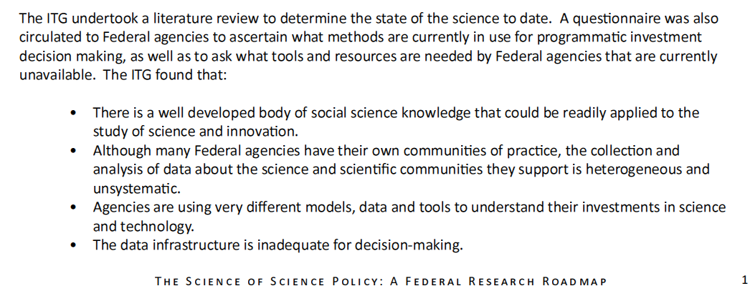

Science Measurement

Slide 38
We don’t know WHAT is funded
Two surveys… provide some of the most significant data available to understand research and development (R&D) spending and policy in the United States. [B]udget officials at science agencies, Congress, and interest groups representing scientists, engineers, and high technology industries, among others, constantly cite the survey results—or studies based on those results—in making public policy arguments. However, the survey data are of insufficient quality and timeliness to support many of the demands put on them. [T]the information provided to SRS is often a rough estimate, frequently based on unexamined assumptions that originated years earlier.” (National Research Council 2010, p. 1, emphases added)

Slide 39
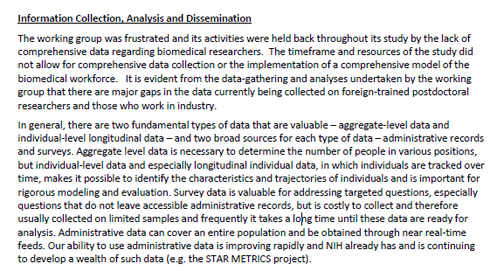
We don’t know WHO is funded
BIOOMEDICAL RESEARCH WORKFORCE WORKING GROUP REPORT, June 14, 2012

Slide 40
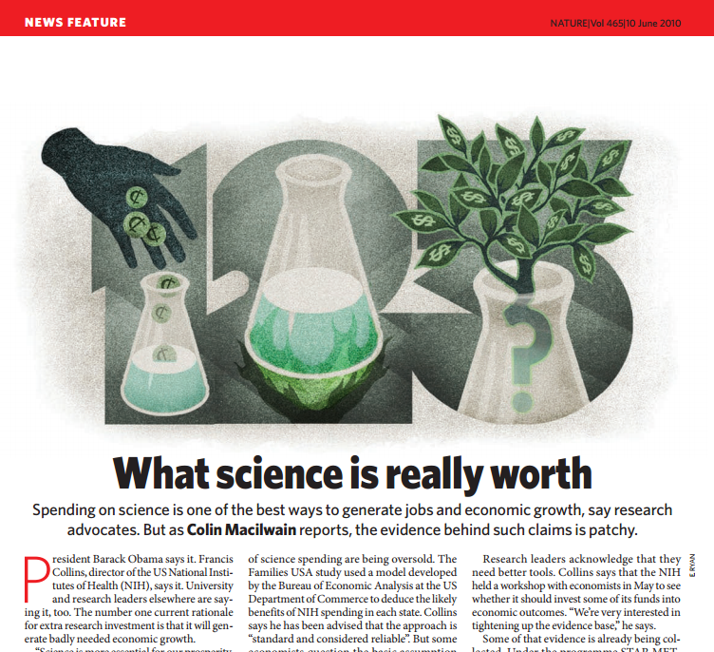
And we don’t know the RESULTS

Slide 41
Approach
Building a feasible, low cost and flexible platform to use science to describe science (for policy)
Conceptual framework: Science is done by scientists (not documents), so focus on scientists & networks of scientists
Empirical framework: Big data approach to collecting data - using new cybertools to capture information automatically
Pragmatic Approach: New ways of presenting information so the public & policymakers can visualize results of research

Slide 42
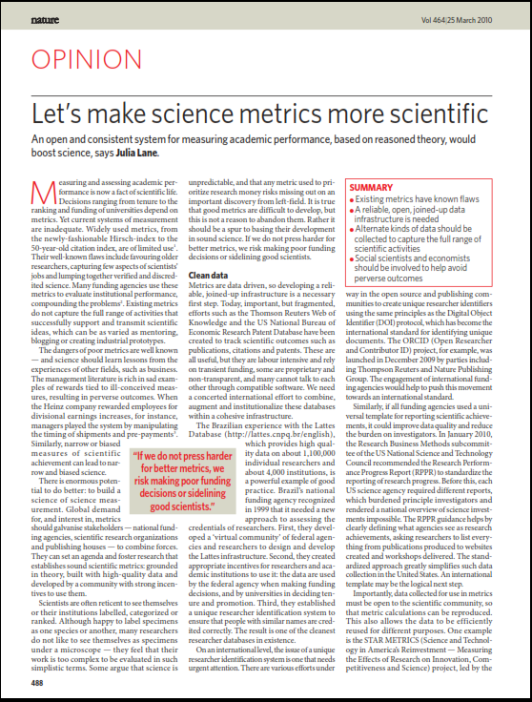
Conceptual Framework
Transmission of research ideas can occur through:
People employed doing research (measured with grants)
Placement of individuals (Oppenheimer – the best way to send knowledge is to wrap it up in a human being)
Start up of businesses
Through social networks
Purchases of equipment and services
Consumer led innovation
Development of comparative advantage
Economies of scale

Slide 43

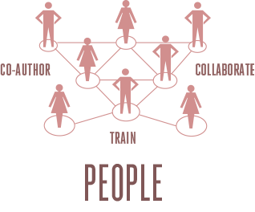

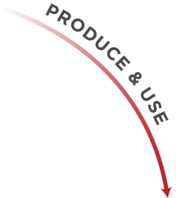




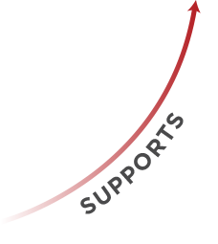

A conceptual framework

Slide 44
A Conceptual Framework
(1) Y_{it}⁽¹⁾ = Y_{it}⁽²⁾α + X_{it}⁽¹⁾λ + ε_{it}
(2) Y_{it}⁽²⁾ = Z_{it}β +X_{it}⁽²⁾μ + η_{it} ,
Y⁽¹⁾ output variables
Y⁽²⁾team composition variables
Both are determined by a set of control variables X⁽¹⁾ and X⁽²⁾ that can overlap and be truly exogenous or predetermined; variable of key interest Z, or research funding

Slide 45
Approach
Level 1: Document the levels and trends in the scientific workforce supported by federal funding.
Level 2: Develop an open automated data infrastructure and tools that will enable the documentation and analysis of a subset of the inputs, outputs, and outcomes resulting from federal investments in science.

Slide 46
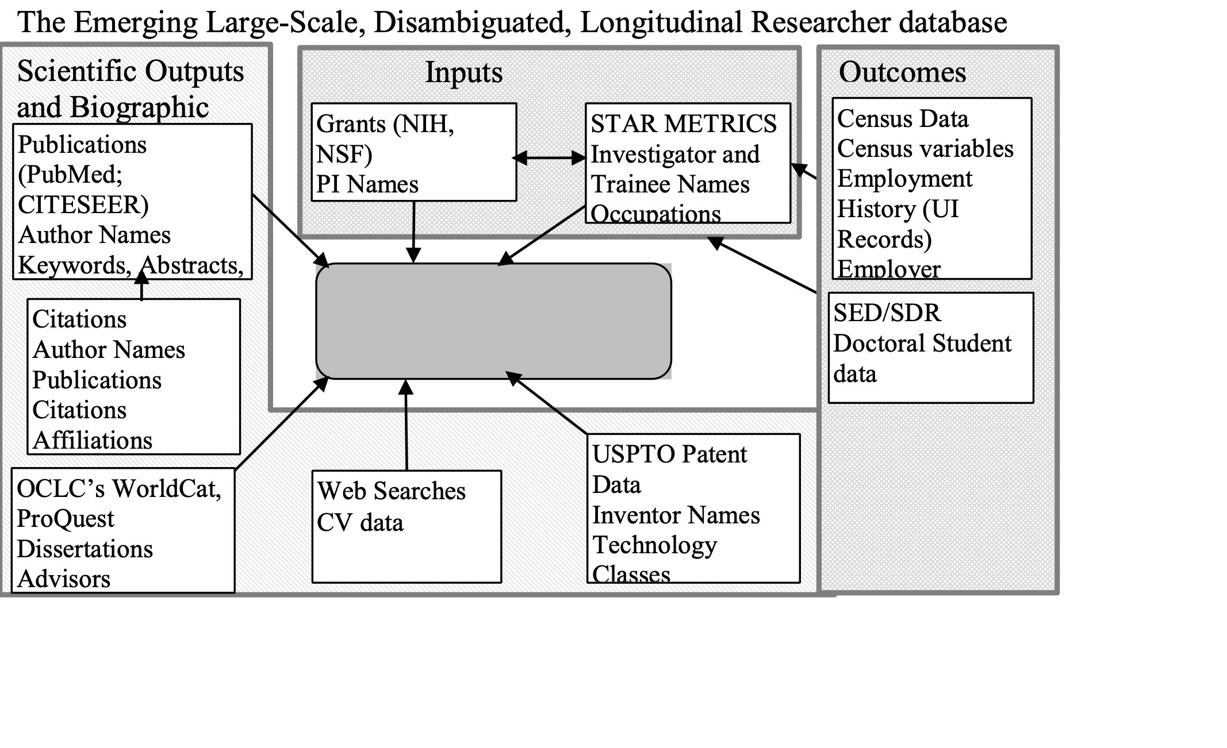

Slide 47
The broader data infrastructure
What has been funded
Text documents
Text analysis
Who has been funded
HR records (individual (plus job title) x grant x pay period)
Inputs
Financial records (vendor x transaction x transaction period)
What are the results
Economic – Census and USPTO data
Scientific – Pubs/scientific communications

Slide 48
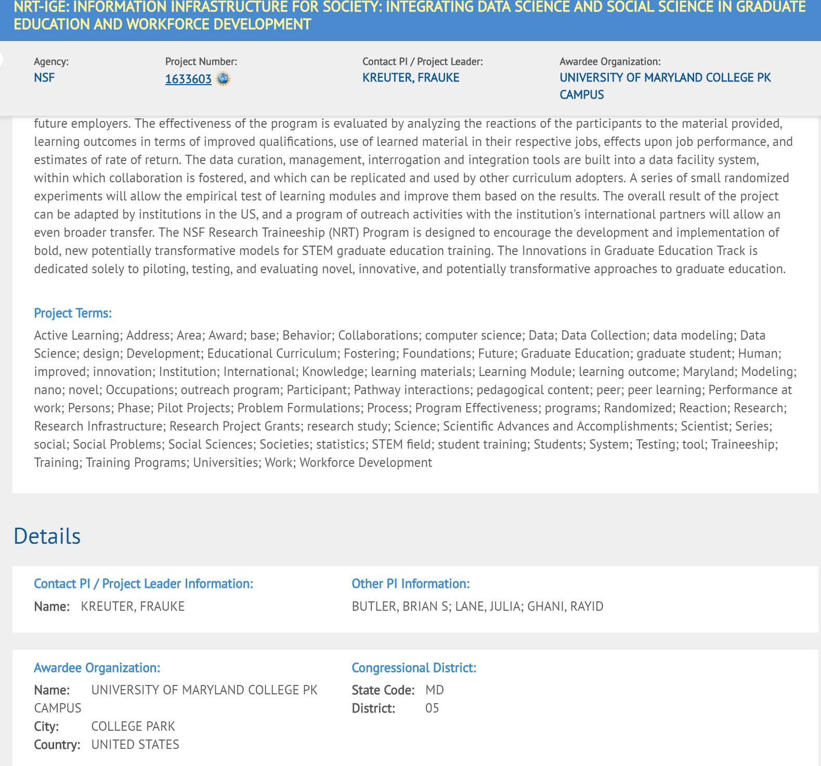
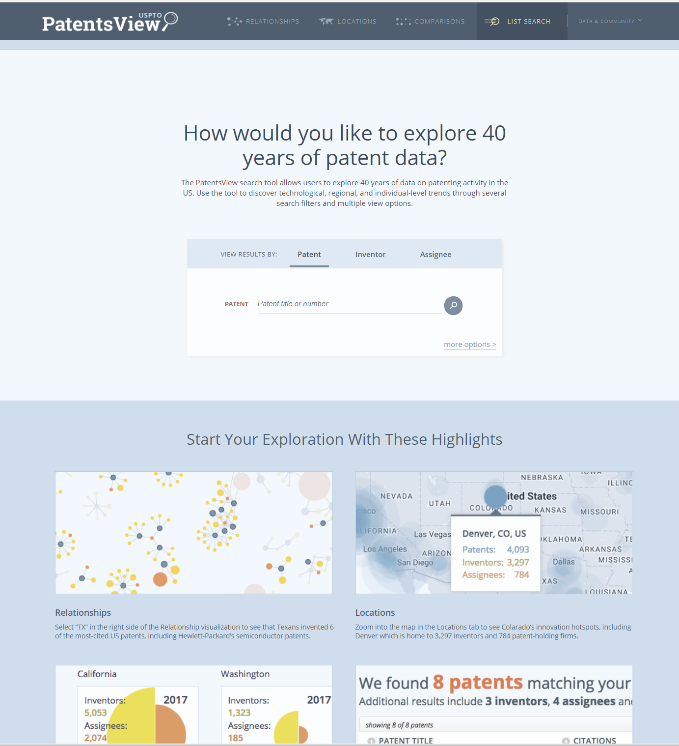
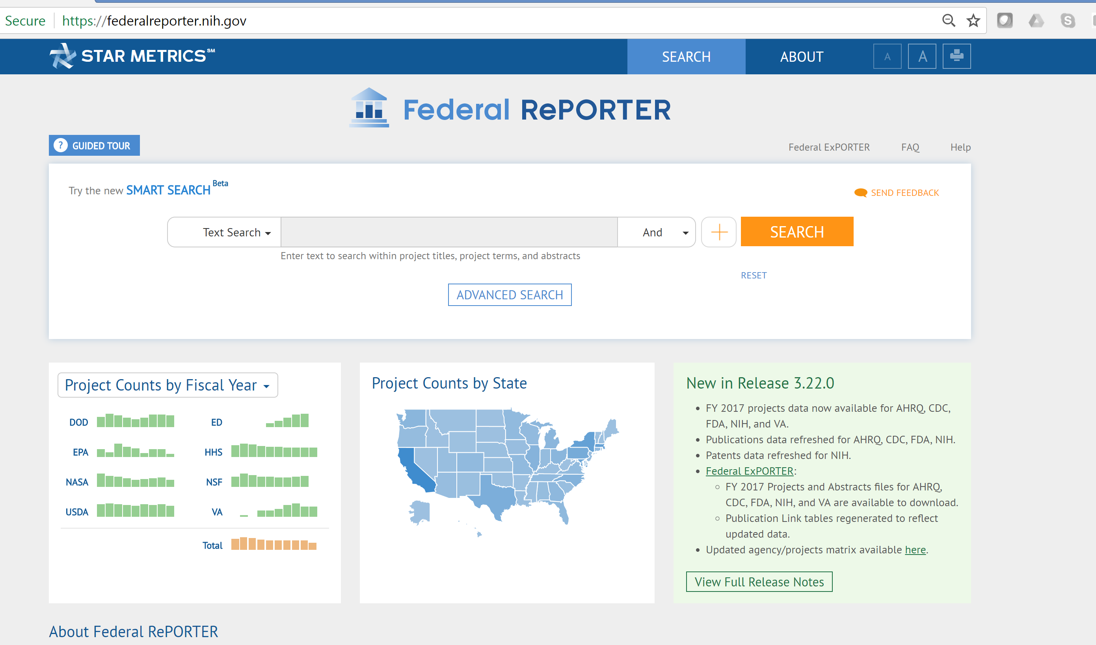
The Empirical Framework for this class

Slide 49
Overview
Housekeeping
Motivation
Goals of class
Specific Approach
Introduction to data
Examples of previous analyses

Slide 50
Overview of Class Data
Data on Federal Grants
Information about each grant
Text of Abstracts from grants
Data on Patents
Information about Patents
Text of Abstracts from Patent

Slide 51
Overview
Housekeeping
Motivation
Goals of class
Specific Approach
Introduction to data
Examples of previous analyses

Slide 52
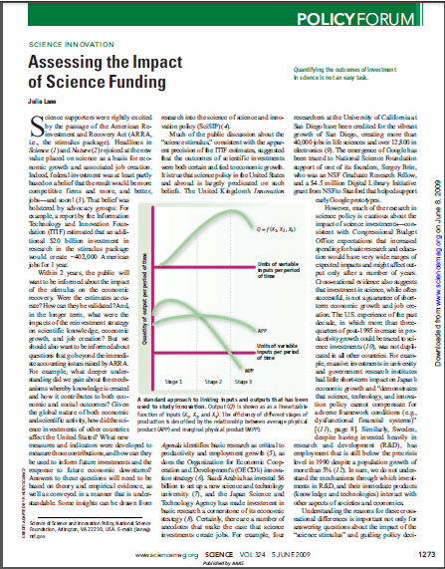
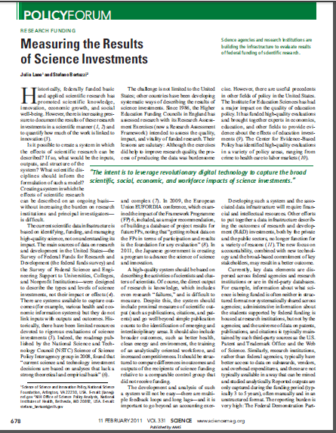
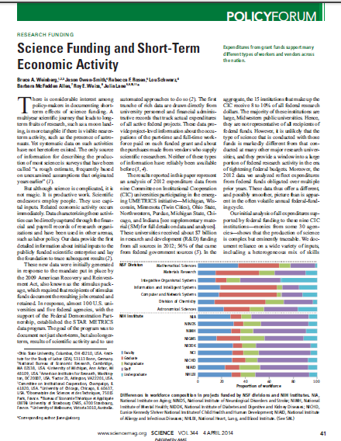
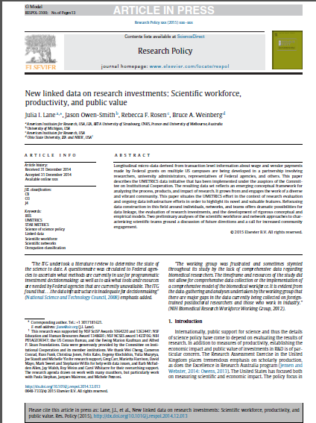
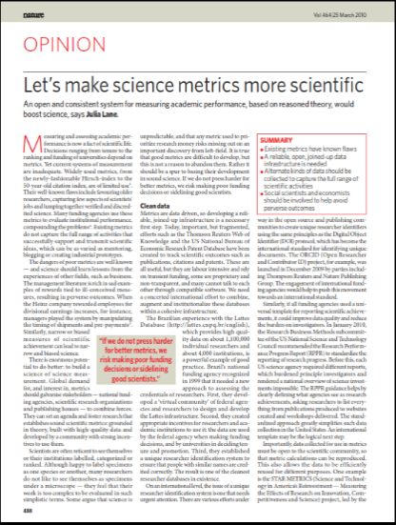
Science, Nature, Research Policy

Slide 53
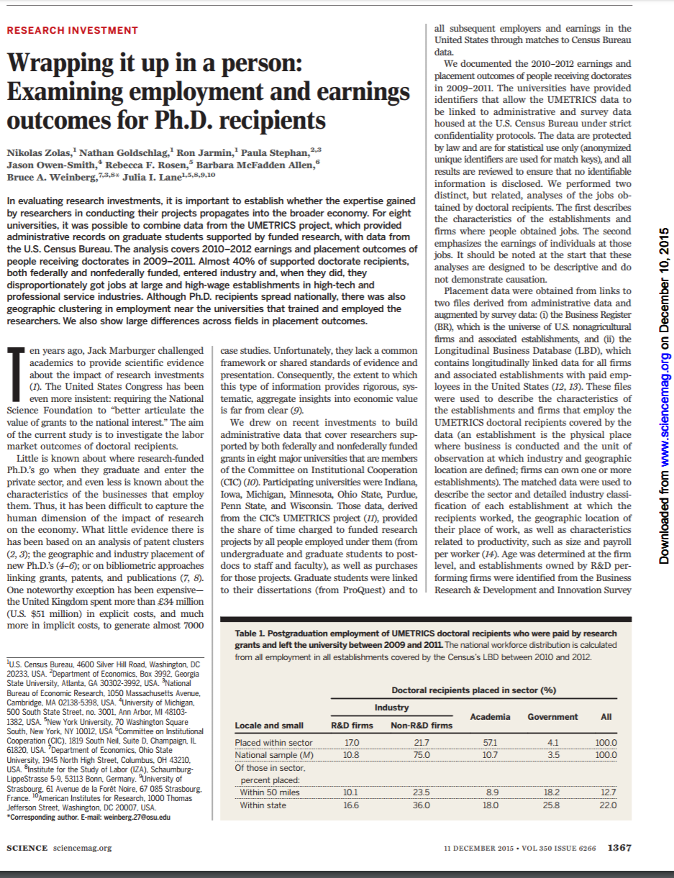


Previous students

Slide 54
Possible Class Projects
Overarching approach
Everybody works on an individual project during the entire class
We allow group projects
You can pick a topic you like working on, but must practice the methods learned in class
Must use the class data
Key points
We are here to help; please ask
Expect the project to evolve during the semester as you get to more the data better

Slide 55
Example Questions I
Text analysis
What are the fields of research based on award abstracts?
What are the fields of research based on patent abstracts?
Linkage
What biases are introduced by different assumptions when you link patent, and grant data?
Machine Learning
What are the predictors of awards?

Slide 56
Example Questions II
Inference
What are the appropriate impact measures? What biases are introduced with different measures
Visualization
Who is getting the most funding? Big teams or small teams? Males or females? What kind of universities? Which fields? What geographic areas?

Slide 57
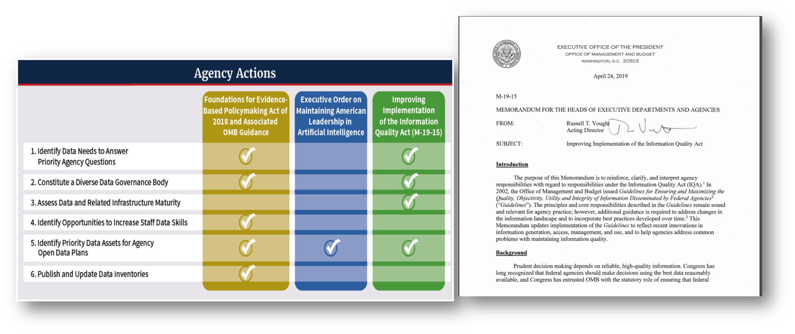
Reminder of why we care

